Slide 1

COIT11241 – Cyber Security Technologies
WK6 A2 – Defend:
Implement safeguard CIS 9.2 Use DNS Filtering Services to block malicious domains.
James Ira Arellano (12161580)

Slide 2
Possible Prerequisites:
To ensure that the script properly runs, double checking the execution policy is recommended.
Run powershell and entering either Set-ExecutionPolicy RemoteSigned or Set-ExecutionPolicy Unrestricted should allow the script to run.
In the host machine, Script Analyzer needs to be installed separately, this can be done by inputting commands:
Install-Module -Name PSScriptAnalyzer –Force
Import-Module PSScriptAnalyzer (needs to be done per session of powershell)

Slide 3
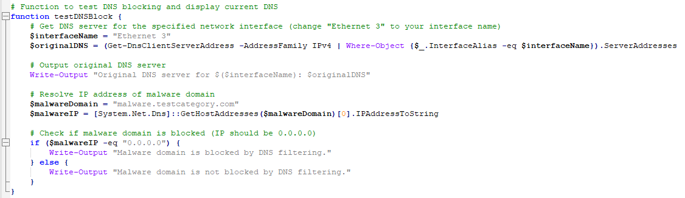

Creating the Defend.ps1Powershell Script
This covers Step 1 – 3 of the task which displays the current DNS of a specified DNS server (can be changed later depending on which internet adapter is used) and displays whether the domain is currently blocked by DNS filtering or not.

Slide 4
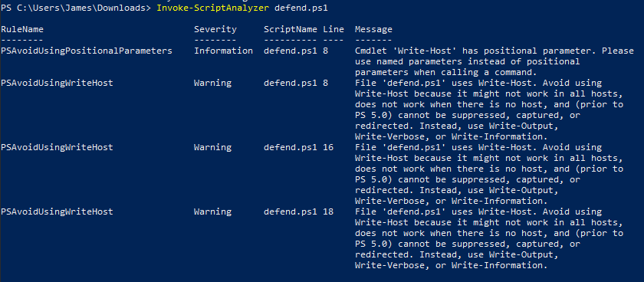
PS Script Analyzer
The following step outlines the use of PS Script Analyzer to determine any improvements that can be used within the current script.

Slide 5
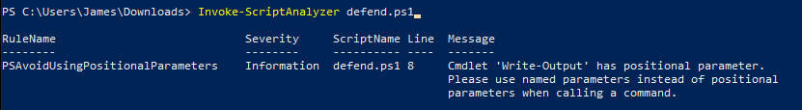
Implementing PS Script Analyzer Results
To get rid of these errors, a simple fix to all Write-Host commands in the script to Write-Output should clear the Script Analyzer recommendations.
The remaining error is classified as Information instead of Severity which can be left alone for now unlike the previous ones which were classified as Warnings.

Slide 6
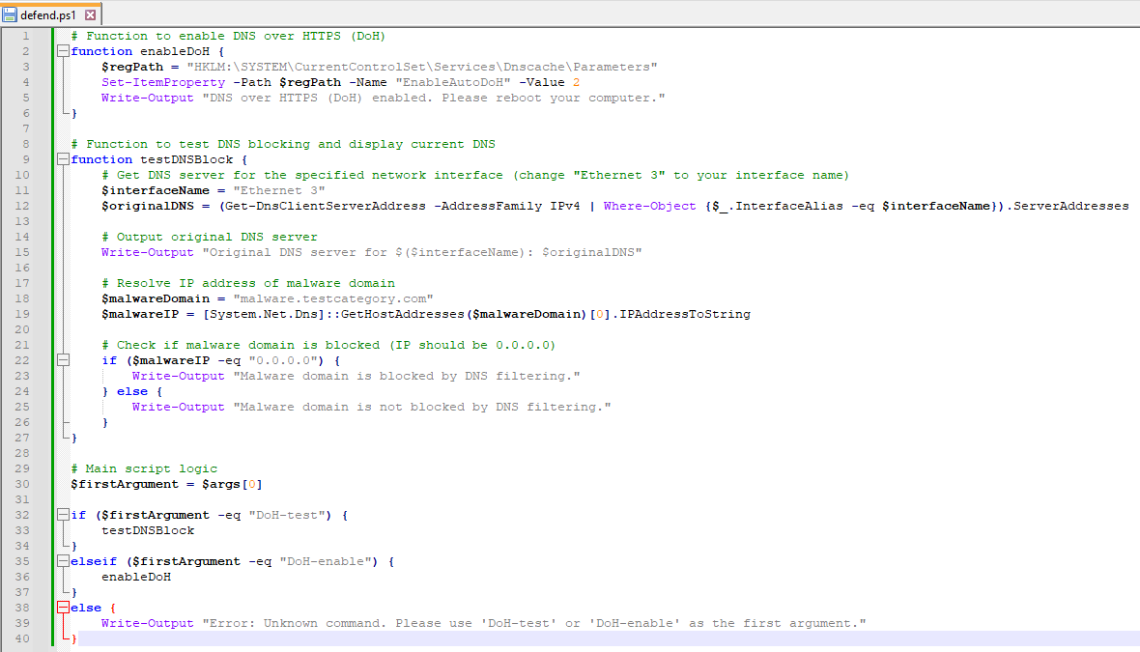
Enable the DNS over HTTPS in Windows 11
This covers Step 5 to enable DNS over HTTPS for Windows 11. It also contains code to test for arguments to ensure the user uses the function they desire. It also checks whether the function they have inputted is correct or not. Invoking Script Analyzer for this code does not result in any warnings, or information outputs.

Slide 7
Enable the DNS over HTTPS in Windows 11
Further code also shows argument checking to ensure separation and easy invoking of specific functions. It also has error checking if the argument inputted was wrong.

Slide 8
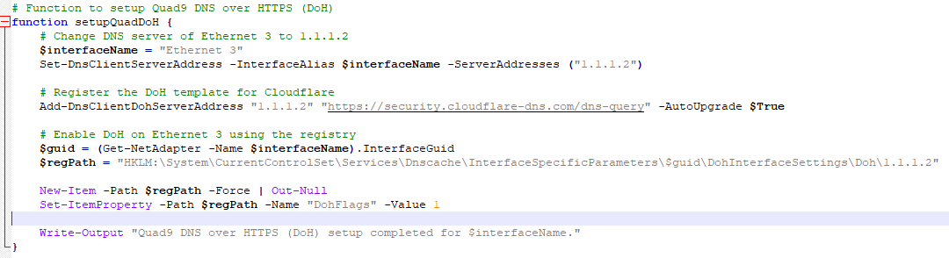
setupQuadDoH() function
This covers Step 6 of the task.
This function changes the DNS of Ethernet NIC 3 to use the Cloudflare DNS.

Slide 9
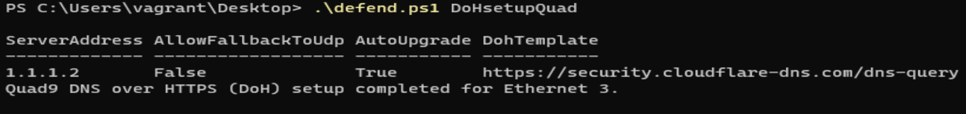
setupQuadDoH() function testing
Running the command “.\defend.ps1 DoHsetupQuad” when powershell is in the same location as the defend.ps1 file is as follows:
Running ScriptAnalyzer once again does not produce any recommendations.

Slide 10
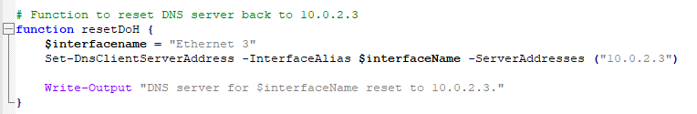
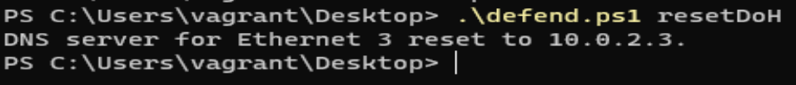
resetDoH() function
This function is self-explanatory, it is responsible for reverting the DNS server value back to 10.0.2.3

Slide 11
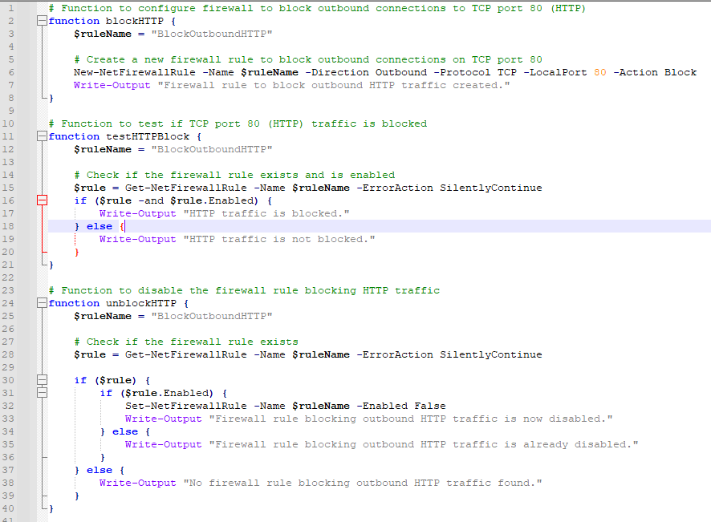
Windows 11 Firewall Configuration
This is responsible for blocking outbound connections to TCP port 80. It also has functions to test if the blocking is set and a disabler.

Slide 12
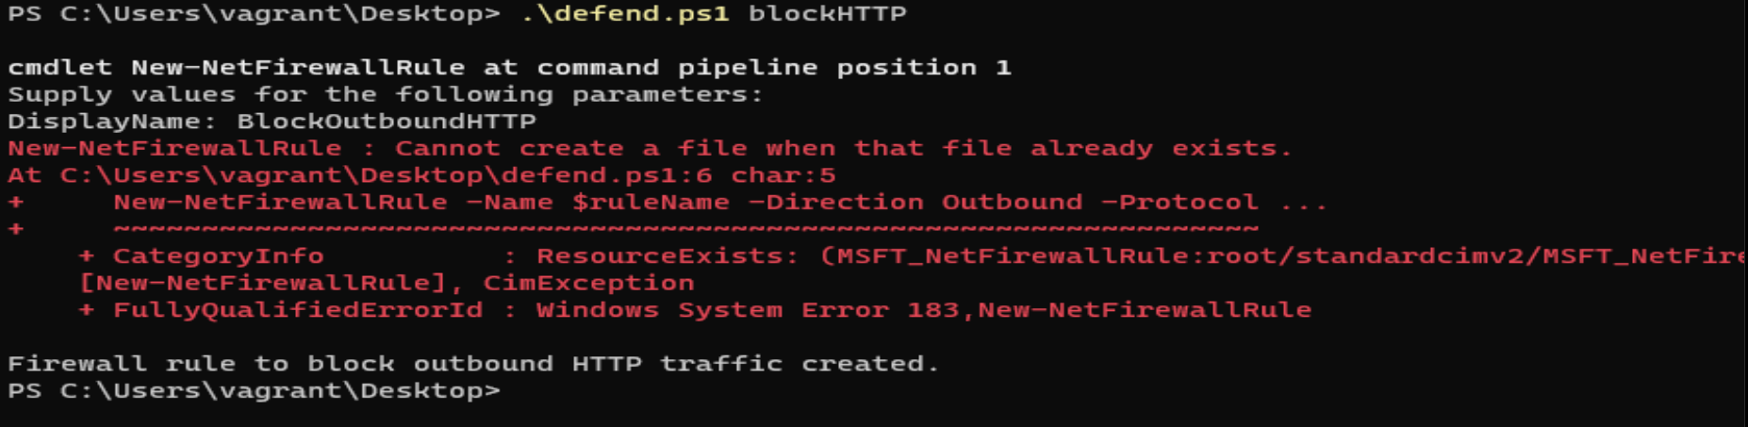
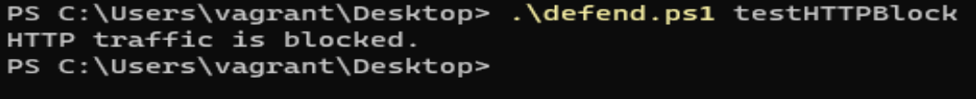
Windows 11 Firewall Configuration Testing
blockHTTP is as follows: Error only exists because there is already a file containing this new firewall rule in place.
testHTTPBlock results are as follows:

Slide 13
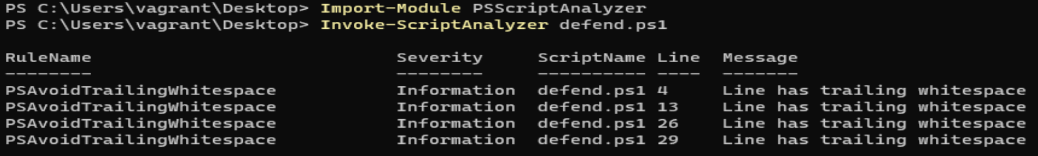
Windows 11 Firewall Configuration Testing
unblockHTTP is as follows:
With the entire code, ScriptAnalyzer was once again ran to ensure there were no recommendations or warnings to deal with.
These PSAvoidTrailingWhitespace warnings were quickly resolved after the initial pass.

Slide 14
References and Sources
ChatGPT: https://chat.openai.com/share/dc01976e-42b6-47ff-83d1-912c36501976
GitHub Repository: https://github.com/AikyanP/COIT11241---WK6-A2-Defend/tree/main

